Slide 1


Machine Learning 11. Support Vector Machine
Xueyuan Gong
School of Intelligent Systems Science and Engineering

Slide 2
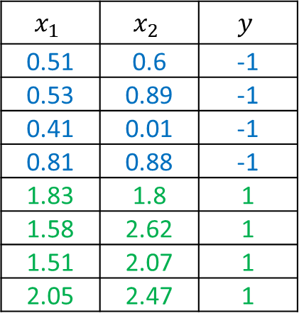
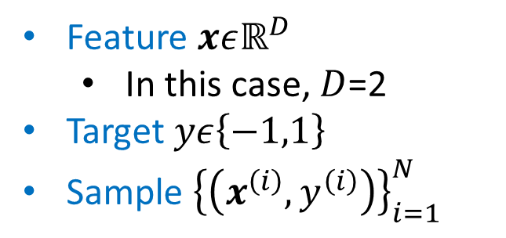
Binary Classification
Dataset
Feature $xεℝ^{D}$
In this case, $D$=2
Target $yε\left\{−1,1\right\}$
Sample ${\left\{\left(x^{\left(i\right)},y^{\left(i\right)}\right)\right\}}_{i=1}^{N}$
$$x_{1}$$ | $$x_{2}$$ | $$y$$
0.51 | 0.6 | -1
0.53 | 0.89 | -1
0.41 | 0.01 | -1
0.81 | 0.88 | -1
1.83 | 1.8 | 1
1.58 | 2.62 | 1
1.51 | 2.07 | 1
2.05 | 2.47 | 1
They are the same for Perceptron
Yet, they are different for Support Vector Machine

Slide 3
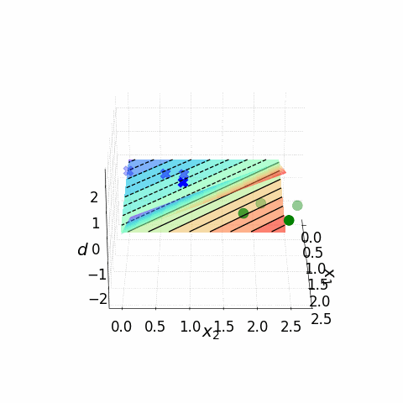
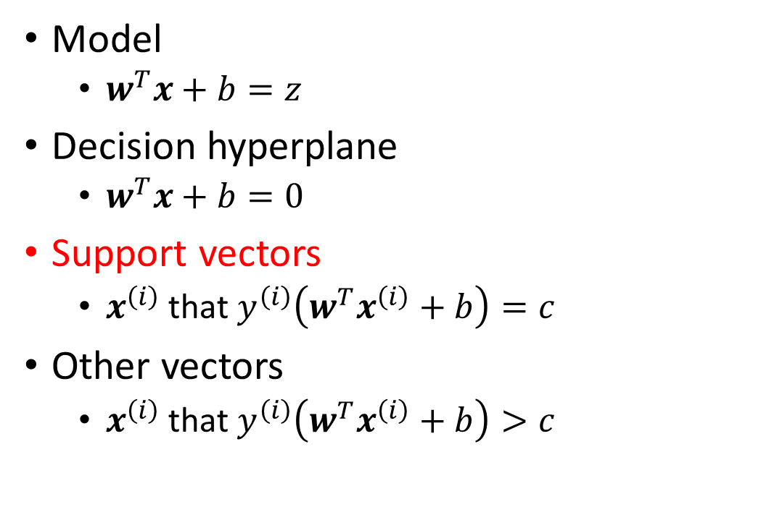
Max Margin Problem
Model
$w^{T}x+b=z$
Decision hyperplane
$w^{T}x+b=0$
Support vectors
$x^{\left(i\right)}$ that $y^{\left(i\right)}\left(w^{T}x^{\left(i\right)}+b\right)=c$
Other vectors
$x^{\left(i\right)}$ that $y^{\left(i\right)}\left(w^{T}x^{\left(i\right)}+b\right)>c$

Slide 4
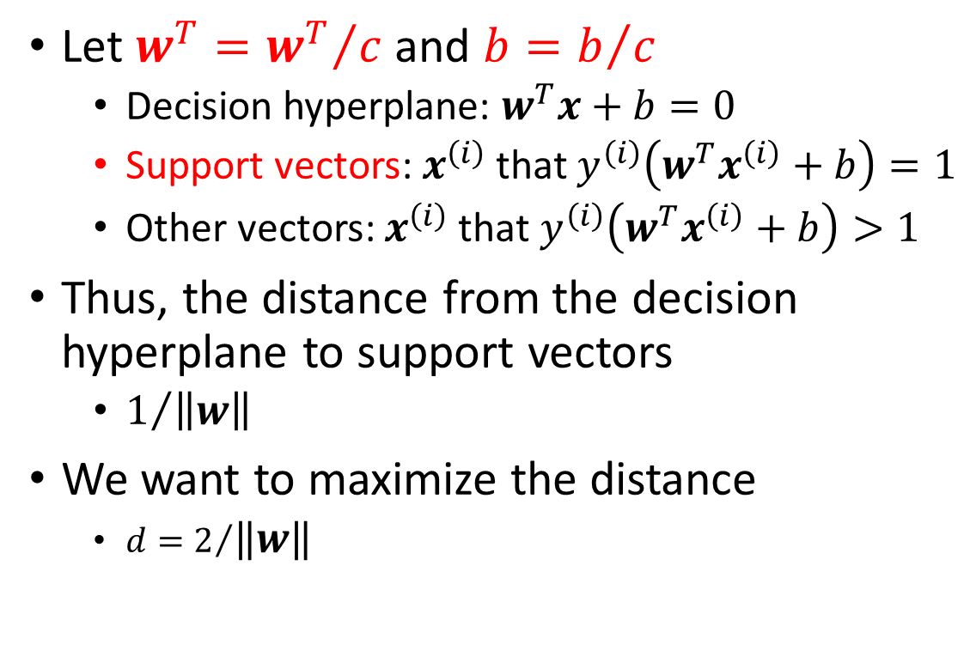
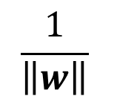
Max Margin Problem
Let $w^{T}={w^{T}}/c$ and $b=b/c$
Decision hyperplane: $w^{T}x+b=0$
Support vectors: $x^{\left(i\right)}$ that $y^{\left(i\right)}\left(w^{T}x^{\left(i\right)}+b\right)=1$
Other vectors: $x^{\left(i\right)}$ that $y^{\left(i\right)}\left(w^{T}x^{\left(i\right)}+b\right)>1$
Thus, the distance from the decision hyperplane to support vectors
$1/{\left\|w\right\|}$
We want to maximize the distance
${d=2}/{\left\|w\right\|}$
$$\frac{1}{\left\|w\right\|}$$

Slide 5
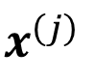
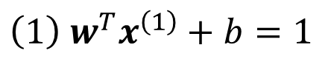
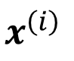
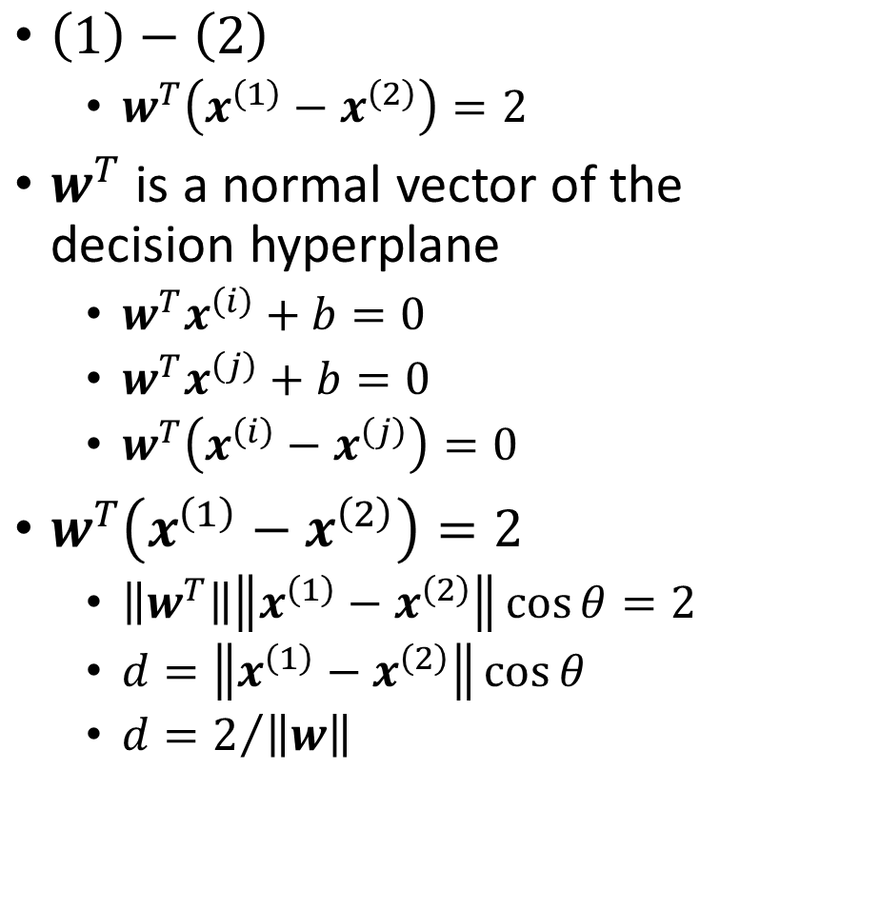
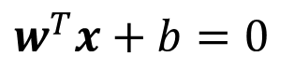
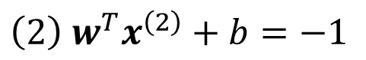
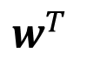
Max Margin Problem
$\left(1\right)−\left(2\right)$
$w^{T}\left(x^{\left(1\right)}−x^{\left(2\right)}\right)=2$
$w^{T}$ is a normal vector of the decision hyperplane
$w^{T}x^{\left(i\right)}+b=0$
$w^{T}x^{\left(j\right)}+b=0$
$w^{T}\left(x^{\left(i\right)}−x^{\left(j\right)}\right)=0$
$w^{T}\left(x^{\left(1\right)}−x^{\left(2\right)}\right)=2$
$\left\|w^{T}\right\|\left\|x^{\left(1\right)}−x^{\left(2\right)}\right\|\cos{θ}=2$
$d=\left\|x^{\left(1\right)}−x^{\left(2\right)}\right\|\cos{θ}$
${d=2}/{\left\|w\right\|}$
$$w^{T}x+b=0$$
$$\left(1\right) w^{T}x^{\left(1\right)}+b=1$$
$$x^{\left(i\right)}$$
$$w^{T}$$
$$x^{\left(j\right)}$$
$$\left(2\right) w^{T}x^{\left(2\right)}+b=−1$$

Slide 6
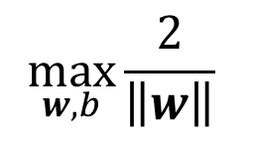
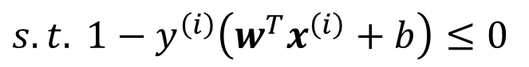
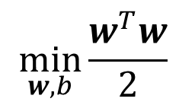
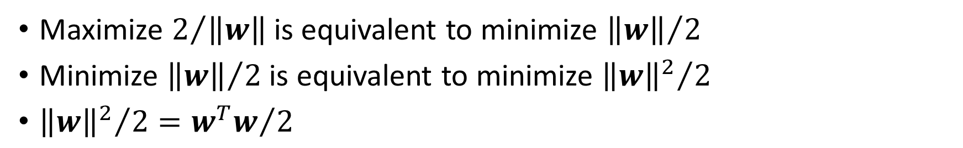
Max Margin Problem
$$\max_{w,b}{\frac{2}{\left\|w\right\|}}$$
Subject to
$$s.t. y^{\left(i\right)}\left(w^{T}x^{\left(i\right)}+b\right)≥1, i=1,2,…,N$$
Maximize $2/{\left\|w\right\|}$ is equivalent to minimize ${\left\|w\right\|}/2$
Minimize ${\left\|w\right\|}/2$ is equivalent to minimize ${{\left\|w\right\|}^{2}}/2$
${{\left\|w\right\|}^{2}}/2={w^{T}w}/2$
$$\min_{w,b}{\frac{w^{T}w}{2}}$$
$$s.t. 1−y^{\left(i\right)}\left(w^{T}x^{\left(i\right)}+b\right)≤0$$

Slide 7
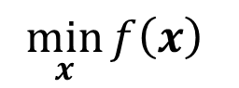
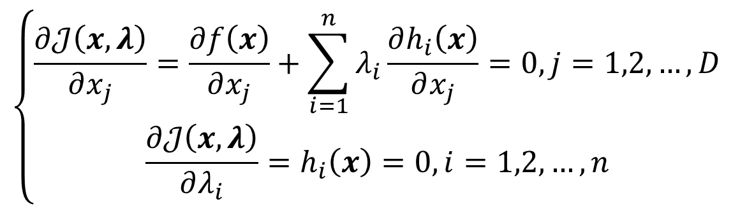
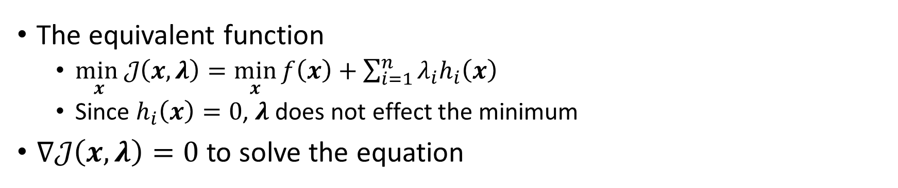
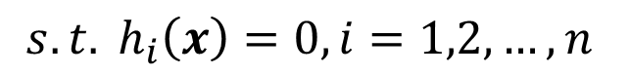
*Lagrange Multiplier with Equality Constraint
$$\min_{x}{f\left(x\right)}$$
$$s.t. h_{i}\left(x\right)=0, i=1,2,…,n$$
The equivalent function
$\min_{x}𝒥\left(x,λ\right)=\min_{x}{f\left(x\right)}+\sum_{i=1}^{n}{λ_{i}h_{i}\left(x\right)}$
Since $h_{i}\left(x\right)=0$, $λ$ does not effect the minimum
$∇𝒥\left(x,λ\right)=0$ to solve the equation
$$\left\{\begin{aligned}\frac{∂𝒥\left(x,λ\right)}{∂x_{j}}=\frac{∂f\left(x\right)}{∂x_{j}}+\sum_{i=1}^{n}{λ_{i}}\frac{∂h_{i}\left(x\right)}{∂x_{j}}=0, j=1,2,…,D \\ \frac{∂𝒥\left(x,λ\right)}{∂λ_{i}}=h_{i}\left(x\right)=0, i=1,2,…,n\end{aligned}\right.$$

Slide 8
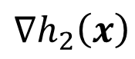
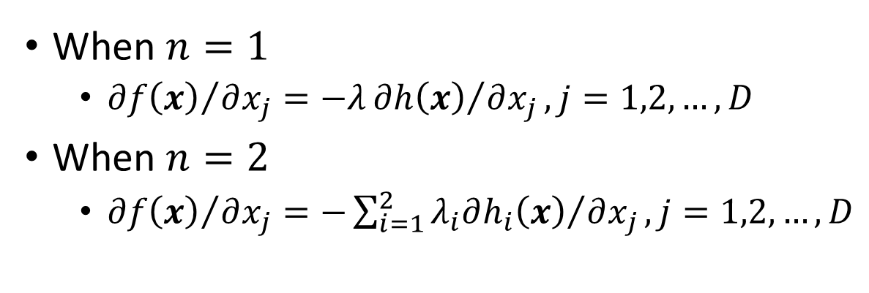
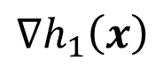
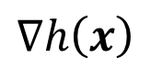
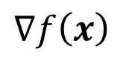
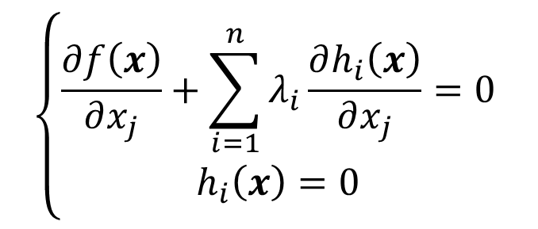
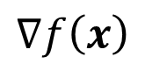
*Lagrange Multiplier with Equality Constraint
$$\left\{\begin{aligned}\frac{∂f\left(x\right)}{∂x_{j}}+\sum_{i=1}^{n}{λ_{i}}\frac{∂h_{i}\left(x\right)}{∂x_{j}}=0 \\ h_{i}\left(x\right)=0\end{aligned}\right.$$
When $n=1$
${∂f\left(x\right)}/{∂x_{j}}=−λ{∂h\left(x\right)}/{∂x_{j}}, j=1,2,…,D$
When $n=2$
${∂f\left(x\right)}/{∂x_{j}}=−\sum_{i=1}^{2}{{λ_{i}∂h_{i}\left(x\right)}/{∂x_{j}}}, j=1,2,…,D$
$$∇f\left(x\right)$$
$$∇f\left(x\right)$$
$$∇h_{2}\left(x\right)$$
$$∇h\left(x\right)$$
$$∇h_{1}\left(x\right)$$

Slide 9
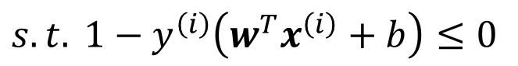
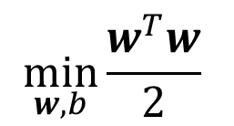
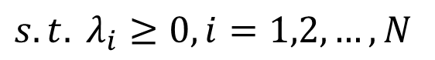
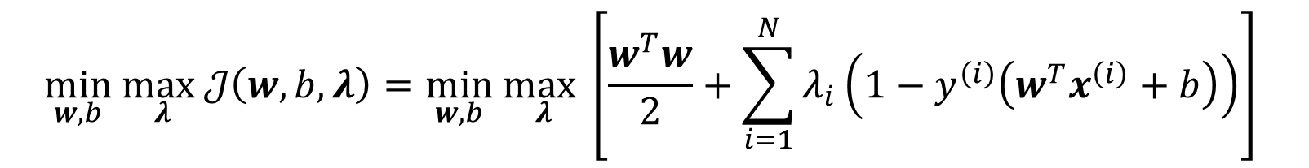
Primal Problem
$$\min_{w,b}{\frac{w^{T}w}{2}}$$
$$s.t. 1−y^{\left(i\right)}\left(w^{T}x^{\left(i\right)}+b\right)≤0$$
However, the max margin problem is a problem with respect to Lagrange multiplier with inequality constraint
This is the primal problem
$$\min_{w,b} \max_{λ}𝒥\left(w,b,λ\right)=\min_{w,b} \max_{λ}\left[\frac{w^{T}w}{2}+\sum_{i=1}^{N}{λ_{i}\left(1−y^{\left(i\right)}\left(w^{T}x^{\left(i\right)}+b\right)\right)}\right]$$
$$s.t. λ_{i}≥0, i=1,2,…,N$$

Slide 10
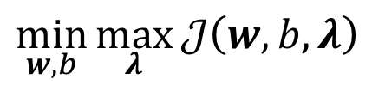
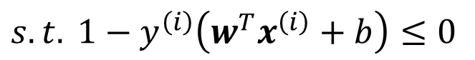
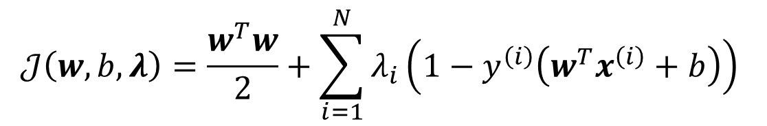
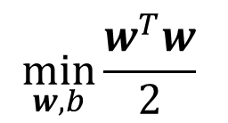
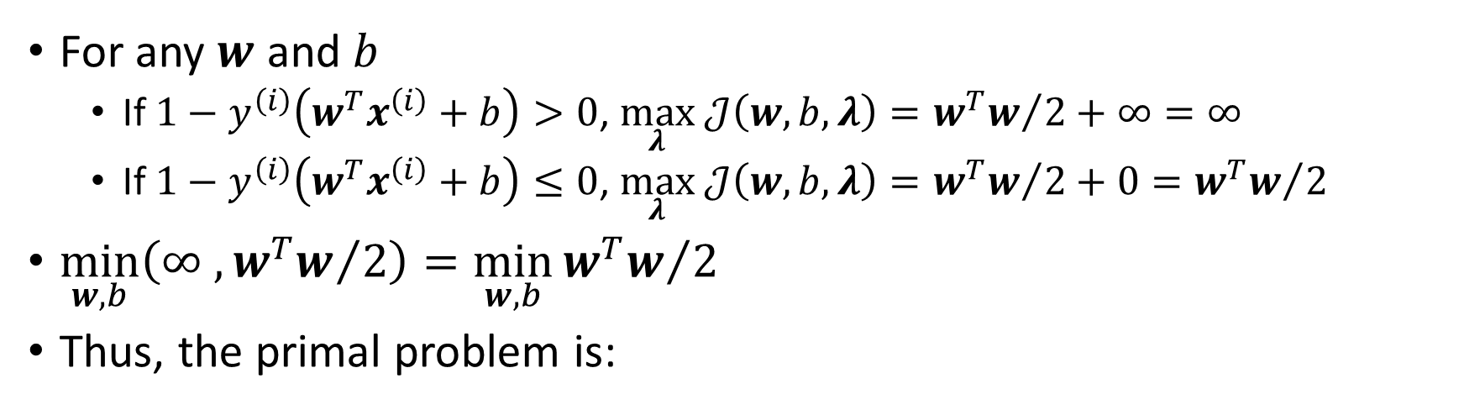
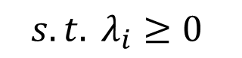
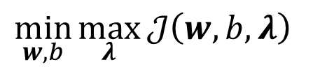
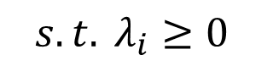
Primal Problem
$$𝒥\left(w,b,λ\right)=\frac{w^{T}w}{2}+\sum_{i=1}^{N}{λ_{i}\left(1−y^{\left(i\right)}\left(w^{T}x^{\left(i\right)}+b\right)\right)}$$
$$\min_{w,b}{\frac{w^{T}w}{2}}$$
Equivalent
$$\min_{w,b}\max_{λ}{𝒥\left(w,b,λ\right)}$$
$$s.t. 1−y^{\left(i\right)}\left(w^{T}x^{\left(i\right)}+b\right)≤0$$
$$s.t. λ_{i}≥0$$
For any $w$ and $b$
If $1−y^{\left(i\right)}\left(w^{T}x^{\left(i\right)}+b\right)>0$, $\max_{λ} 𝒥\left(w,b,λ\right)={w^{T}w}/2+∞=∞$
If $1−y^{\left(i\right)}\left(w^{T}x^{\left(i\right)}+b\right)≤0$, $\max_{λ} 𝒥\left(w,b,λ\right)={w^{T}w}/2+0={w^{T}w}/2$
$\min_{w,b}\left(∞ ,{w^{T}w}/2\right)=\min_{w,b}{{w^{T}w}/2}$
Thus, the primal problem is:
$$\min_{w,b}\max_{λ}{𝒥\left(w,b,λ\right)}$$
$$s.t. λ_{i}≥0$$

Slide 11
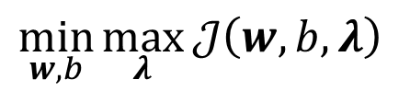
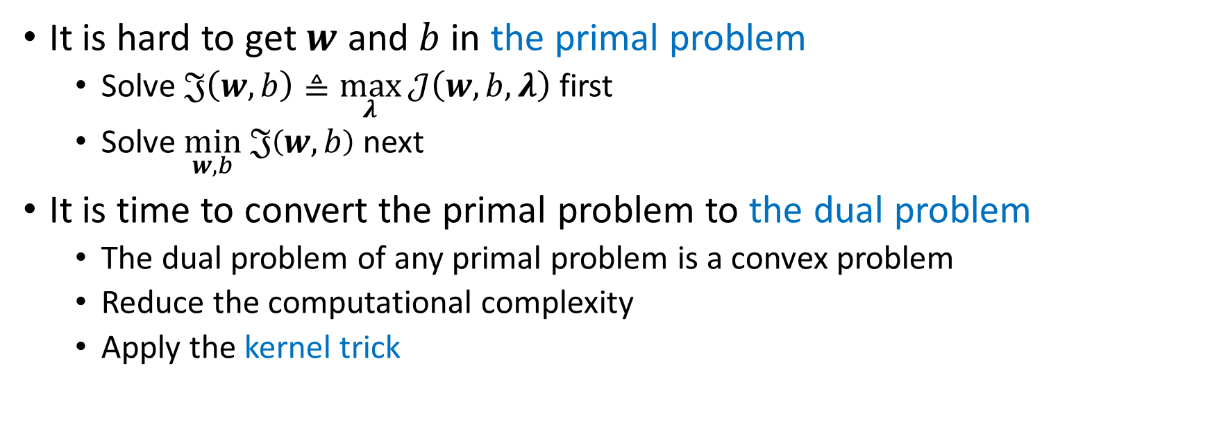
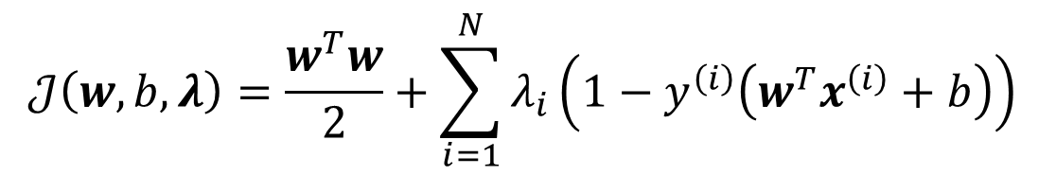
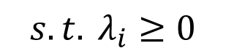
Dual Problem
$$𝒥\left(w,b,λ\right)=\frac{w^{T}w}{2}+\sum_{i=1}^{N}{λ_{i}\left(1−y^{\left(i\right)}\left(w^{T}x^{\left(i\right)}+b\right)\right)}$$
$$\min_{w,b}\max_{λ}{𝒥\left(w,b,λ\right)}$$
$$s.t. λ_{i}≥0$$
It is hard to get $w$ and $b$ in the primal problem
Solve $𝔍\left(w,b\right)≜\max_{λ}{𝒥\left(w,b,λ\right)}$ first
Solve $\min_{w,b} 𝔍\left(w,b\right)$ next
It is time to convert the primal problem to the dual problem
The dual problem of any primal problem is a convex problem
Reduce the computational complexity
Apply the kernel trick

Slide 12
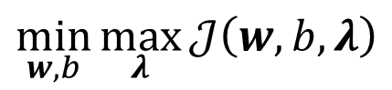
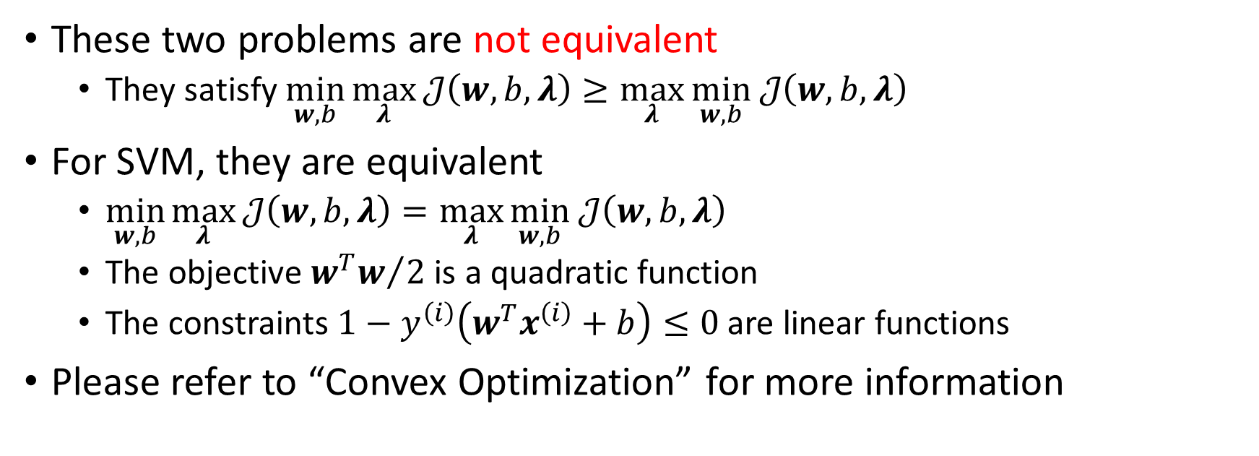
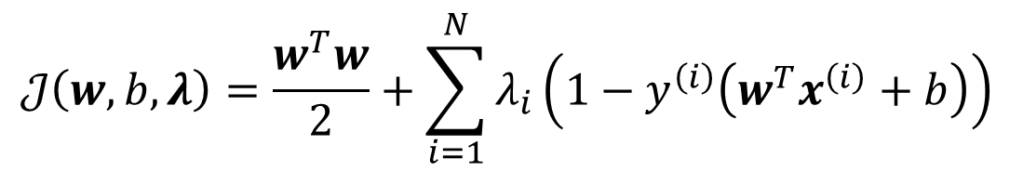
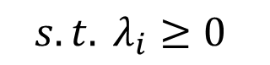
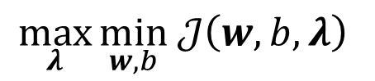
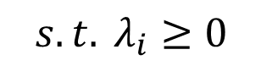
Dual Problem
$$𝒥\left(w,b,λ\right)=\frac{w^{T}w}{2}+\sum_{i=1}^{N}{λ_{i}\left(1−y^{\left(i\right)}\left(w^{T}x^{\left(i\right)}+b\right)\right)}$$
Primal problem
Dual problem
$$\min_{w,b}\max_{λ}{𝒥\left(w,b,λ\right)}$$
$$\max_{λ}{\min_{w,b} 𝒥\left(w,b,λ\right)}$$
$$s.t. λ_{i}≥0$$
$$s.t. λ_{i}≥0$$
These two problems are not equivalent
They satisfy $\min_{w,b}\max_{λ}{𝒥\left(w,b,λ\right)}≥\max_{λ}{\min_{w,b} 𝒥\left(w,b,λ\right)}$
For SVM, they are equivalent
$\min_{w,b}\max_{λ}{𝒥\left(w,b,λ\right)}=\max_{λ}{\min_{w,b} 𝒥\left(w,b,λ\right)}$
The objective ${w^{T}w}/2$ is a quadratic function
The constraints $1−y^{\left(i\right)}\left(w^{T}x^{\left(i\right)}+b\right)≤0$ are linear functions
Please refer to “Convex Optimization” for more information
Strong duality theorem

Slide 13


Lagrange Multiplier with Inequality Constraint
$$\min_{x}{f\left(x\right)}$$
$$s.t. g_{i}\left(x\right)≤0, i=1,2,…,n$$
The primal problem
$\min_{x}\max_{λ}𝒥\left(x,λ\right)=\min_{x}\max_{λ}\left[f\left(x\right)+\sum_{i=1}^{n}{λ_{i}g_{i}\left(x\right)}\right]$
$λ_{i}≥0, i=1,2,…,n$
The dual problem
$\max_{λ}\min_{x}𝒥\left(x,λ\right)=\max_{λ}{\min_{x}\left[f\left(x\right)+\sum_{i=1}^{n}{λ_{i}g_{i}\left(x\right)}\right]}$
$λ_{i}≥0, i=1,2,…,n$
For a convex optimization problem, $\min_{w,b}\max_{λ}{𝒥\left(w,b,λ\right)}=\max_{λ}{\min_{w,b} 𝒥\left(w,b,λ\right)}$ holds when the Karush–Kuhn–Tucker (KKT) conditions satisfy
Strong duality theorem

Slide 14




Lagrange Multiplier with Inequality Constraint
$$\left\{\begin{aligned}\begin{aligned}\frac{∂f\left(x\right)}{∂x_{j}}+\sum_{i=1}^{n}{λ_{i}}\frac{∂g_{i}\left(x\right)}{∂x_{j}}=0 \\ g_{i}\left(x\right)≤0 \\ λ_{i}≥0\end{aligned} \\ λ_{i}g_{i}\left(x\right)=0\end{aligned}\right.$$
$$i=1,2,…,n$$
KKT conditions
$$j=1,2,…,D$$
Complementary slackness
When $n=1$
$g\left(x\right)<0$
$g\left(x\right)=0$
When $n=2$
$g_{1}\left(x\right)=0,g_{2}\left(x\right)=0$
When $n=3$
$g_{1}\left(x\right)=0,g_{2}\left(x\right)=0$, $g_{3}\left(x\right)<0$

Slide 15



Dual Problem
$$𝒥\left(w,b,λ\right)=\frac{w^{T}w}{2}+\sum_{i=1}^{N}{λ_{i}\left(1−y^{\left(i\right)}\left(w^{T}x^{\left(i\right)}+b\right)\right)}$$
$$\max_{λ}{\min_{w,b} 𝒥\left(w,b,λ\right)}$$
$$s.t. λ_{i}≥0$$
Complementary slackness tells us an important conclusion
Either $λ_{i}>0, 1−y^{\left(i\right)}\left(w^{T}x^{\left(i\right)}+b\right)=0$
Or $λ_{i}=0, 1−y^{\left(i\right)}\left(w^{T}x^{\left(i\right)}+b\right)<0$
Interestingly
Support vectors: $λ_{i}>0$
Other vectors: $λ_{i}=0$

Slide 16






Dual Problem
$$𝒥\left(w,b,λ\right)=\frac{w^{T}w}{2}+\sum_{i=1}^{N}{λ_{i}\left(1−y^{\left(i\right)}\left(w^{T}x^{\left(i\right)}+b\right)\right)}$$
$$\max_{λ}{\min_{w,b} 𝒥\left(w,b,λ\right)}$$
$$s.t. λ_{i}≥0$$
Let us solve $\min_{w,b} 𝒥\left(w,b,λ\right)$ now
$$\frac{∂𝒥\left(w,b,λ\right)}{∂w_{j}}=\frac{∂}{∂w_{j}}\left[\frac{w^{T}w}{2}+\sum_{i=1}^{N}{λ_{i}\left(1−y^{\left(i\right)}\left(w^{T}x^{\left(i\right)}+b\right)\right)}\right]=$$
$$w_{j}−\sum_{i=1}^{N}{λ_{i}y^{\left(i\right)}x_{j}^{\left(i\right)}}=0$$
$$−\sum_{i=1}^{N}{λ_{i}y^{\left(i\right)}}=0$$
$$\frac{∂𝒥\left(w,b,λ\right)}{∂b}=$$

Slide 17







Dual Problem
$$w_{j}=\sum_{i=1}^{N}{λ_{i}y^{\left(i\right)}x_{j}^{\left(i\right)}}$$
$$w=\sum_{i=1}^{N}{λ_{i}y^{\left(i\right)}x^{\left(i\right)}}$$
Yet, we still need to calculate $b$
We know for support vectors ($λ_{j}>0$)
$y^{\left(j\right)}\left(w^{T}x^{\left(j\right)}+b\right)=1$
Thus, as long as we know which $λ_{j}>0$, in other words, which $x^{\left(j\right)}$ are support vectors, we can calculate $b$
$${1=y}^{\left(j\right)}\left(w^{T}x^{\left(j\right)}+b\right)$$
$$b=\frac{1}{y^{\left(j\right)}}−w^{T}x^{\left(j\right)}$$
Now, solve $λ$ and all done
$$b=y^{\left(j\right)}−\sum_{i=1}^{N}{λ_{i}y^{\left(i\right)}{\left(x^{\left(i\right)}\right)}^{T}}x^{\left(j\right)}$$

Slide 18



Dual Problem
$$w=\sum_{i=1}^{N}{λ_{i}y^{\left(i\right)}x^{\left(i\right)}}$$
$$\sum_{i=1}^{N}{λ_{i}y^{\left(i\right)}}=0$$
$$𝒥\left(w,b,λ\right)=\frac{w^{T}w}{2}+\sum_{i=1}^{N}{λ_{i}\left(1−y^{\left(i\right)}\left(w^{T}x^{\left(i\right)}+b\right)\right)}$$
$$=\frac{w^{T}}{2}\sum_{i=1}^{N}{λ_{i}y^{\left(i\right)}x^{\left(i\right)}}+\sum_{i=1}^{N}{\left(λ_{i}−λ_{i}y^{\left(i\right)}w^{T}x^{\left(i\right)}−λ_{i}y^{\left(i\right)}b\right)}=\sum_{i=1}^{N}{λ_{i}}+\frac{1}{2}\sum_{i=1}^{N}{λ_{i}y^{\left(i\right)}{w^{T}x}^{\left(i\right)}}−\sum_{i=1}^{N}{λ_{i}y^{\left(i\right)}w^{T}x^{\left(i\right)}}=\sum_{i=1}^{N}{λ_{i}}−\frac{1}{2}\sum_{i=1}^{N}{\sum_{j=1}^{N}{λ_{i}λ_{j}}}y^{\left(i\right)}y^{\left(j\right)}{\left(x^{\left(i\right)}\right)}^{T}x^{\left(j\right)}$$

Slide 19





Dual Problem
$$\max_{λ} 𝒥\left(λ\right)=\sum_{i=1}^{N}{λ_{i}}−\frac{1}{2}\sum_{i=1}^{N}{\sum_{j=1}^{N}{λ_{i}λ_{j}}}y^{\left(i\right)}y^{\left(j\right)}{\left(x^{\left(i\right)}\right)}^{T}x^{\left(j\right)}$$
$$w=\sum_{i=1}^{N}{λ_{i}y^{\left(i\right)}x^{\left(i\right)}}$$
It is equivalent to minimize the minus of the objective
$$\min_{λ} 𝒥\left(λ\right)=\frac{1}{2}\sum_{i=1}^{N}{\sum_{j=1}^{N}{λ_{i}λ_{j}}}y^{\left(i\right)}y^{\left(j\right)}{\left(x^{\left(i\right)}\right)}^{T}x^{\left(j\right)}−\sum_{i=1}^{N}{λ_{i}}$$
$$s.t. λ_{i}≥0$$
$$\sum_{i=1}^{N}{λ_{i}y^{\left(i\right)}}=0$$
We are able to solve it manually
Alternatively, we can solve it automatically by Sequential minimal optimization (SMO)
Learn SMO by yourself if you are interested

Slide 20

Summary
Input a dataset ${D=\left\{\left(x^{\left(i\right)},y^{\left(i\right)}\right)\right\}}_{i=1}^{N}$, where $x^{\left(i\right)}εℝ^{D}$ and $y^{\left(i\right)}ε\left\{−1,1\right\}$
Solve $\min_{λ} 𝒥\left(λ\right)=\frac{1}{2}\sum_{i=1}^{N}{\sum_{j=1}^{N}{λ_{i}λ_{j}}}y^{\left(i\right)}y^{\left(j\right)}{\left(x^{\left(i\right)}\right)}^{T}x^{\left(j\right)}−\sum_{i=1}^{N}{λ_{i}}$
$s.t. λ_{i}≥0$, $\sum_{i=1}^{N}{λ_{i}y^{\left(i\right)}}=0$
Now we have $λ^{∗}={\left[λ_{1}^{∗},λ_{2}^{∗},…,λ_{N}^{∗}\right]}^{T}$
Calculate $w^{∗}=\sum_{i=1}^{N}{λ_{i}^{∗}y^{\left(i\right)}x^{\left(i\right)}}$
For a $x^{\left(j\right)}$ that $λ_{j}^{∗}>0$, calculate $b^{∗}=y^{\left(j\right)}−\sum_{i=1}^{N}{λ_{i}^{∗}y^{\left(i\right)}{\left(x^{\left(i\right)}\right)}^{T}}x^{\left(j\right)}$
Then, the SVM decision hyperplane is ${\left(w^{∗}\right)}^{T}x+b^{∗}=0$

Slide 21






Example
$$\min_{λ} 𝒥\left(λ\right)=\frac{1}{2}\sum_{i=1}^{N}{\sum_{j=1}^{N}{λ_{i}λ_{j}}}y^{\left(i\right)}y^{\left(j\right)}{\left(x^{\left(i\right)}\right)}^{T}x^{\left(j\right)}−\sum_{i=1}^{N}{λ_{i}}$$
$$\sum_{i=1}^{N}{λ_{i}y^{\left(i\right)}}=0$$
$$s.t. λ_{i}≥0,$$
Suppose the dataset contains two positive samples $x^{\left(1\right)}={\left[3,3\right]}^{T}$ and $x^{\left(2\right)}={\left[4,3\right]}^{T}$, and one negative sample $x^{\left(3\right)}={\left[1,1\right]}^{T}$. Please calculate the SVM decision hyperplane
$$𝒥\left(λ\right)=\frac{1}{2}\left(18λ_{1}^{2}+25λ_{2}^{2}+2λ_{3}^{2}+42λ_{1}λ_{2}−12λ_{1}λ_{3}−14λ_{2}λ_{3}\right)−λ_{1}−λ_{2}−λ_{3}$$
$s.t. λ_{1}≥0,λ_{2}≥0,$ $λ_{3}≥0$
$$λ_{1}+λ_{2}−λ_{3}=0$$

Slide 22





Example
Since $λ_{1}+λ_{2}=λ_{3}$
$$𝒥\left(λ\right)=4λ_{1}^{2}+\frac{13}{2}λ_{2}^{2}+10λ_{1}λ_{2}−2λ_{1}−2λ_{2}$$
$$s.t. λ_{1}≥0,λ_{2}≥0$$
Since $x^{\left(2\right)}$ is not the support vector, $λ_{2}=0$
$$𝒥\left(λ\right)=4λ_{1}^{2}−2λ_{1}$$
$$s.t. λ_{1}≥0$$
Let ${∂𝒥\left(λ\right)}/{∂λ_{1}=0}$, $λ_{1}=1/4$
Since $λ_{1}+λ_{2}=λ_{3}$, $λ_{3}=1/4$

Slide 23





Example
Now, we know $x^{\left(1\right)}={\left[3,3\right]}^{T},$ $x^{\left(2\right)}={\left[4,3\right]}^{T}$, $x^{\left(3\right)}={\left[1,1\right]}^{T}$
Also, we know $y^{\left(1\right)}=1$, $y^{\left(2\right)}=1$, $y^{\left(3\right)}=−1$
Last, we know $λ_{1}=1/4$, $λ_{2}=0$, $λ_{3}=1/4$
$$w=\sum_{i=1}^{N}{λ_{i}y^{\left(i\right)}x^{\left(i\right)}}$$
$$b=y^{\left(j\right)}−\sum_{i=1}^{N}{λ_{i}y^{\left(i\right)}{\left(x^{\left(i\right)}\right)}^{T}}x^{\left(j\right)}$$
$$w={\left[\frac{1}{2},\frac{1}{2}\right]}^{T}$$
$$b=−2$$
The SVM decision hyperplane is $\frac{1}{2}x_{1}+\frac{1}{2}x_{2}−2=0$

Slide 24



The Kernel Trick
First, $x=\left[x_{1},x_{2}\right]$. Yet, it is linearly inseparable
Optionally, use a complex model $z=w_{1}x_{1}+w_{2}x_{2}+w_{3}\left(x_{1}^{2}+x_{2}^{2}\right)$
We can treat it in a different way
$x=\left[x_{1},x_{2},x_{3}\right]=\left[x_{1},x_{2},x_{1}^{2}+x_{2}^{2}\right]$
$z=w_{1}x_{1}+w_{2}x_{2}+w_{3}x_{3}$

Slide 25

The Kernel Trick
Define a kernel function $K\left(x^{\left(i\right)},x^{\left(j\right)}\right)={φ\left(x^{\left(i\right)}\right)}^{T}φ\left(x^{\left(j\right)}\right)$
$K\left(x^{\left(i\right)},x^{\left(j\right)}\right)εℝ$
$φ\left(x\right)$ maps $x$ to a higher dimensional space
Thus, the model $z=w^{T}x+b$ becomes $z=w^{T}φ\left(x\right)+b$
$xεℝ^{D}$ becomes $φ\left(x\right)εℝ^{D_{k}}$
$wεℝ^{D}$ becomes $wεℝ^{D_{k}}$
The more dimension $φ\left(x\right)$ has, the more likely $φ\left(x\right)$ is linearly separable
We can define a $φ\left(x\right)εℝ^{∞}$ instead of calculating it
This is called the kernel trick

Slide 26





The Kernel Trick
$$w=\sum_{i=1}^{N}{λ_{i}y^{\left(i\right)}x^{\left(i\right)}}$$
$$b=y^{\left(j\right)}−\sum_{i=1}^{N}{λ_{i}y^{\left(i\right)}{\left(x^{\left(i\right)}\right)}^{T}}x^{\left(j\right)}$$
After applying the kernel function
$$w=\sum_{i=1}^{N}{λ_{i}y^{\left(i\right)}φ\left(x^{\left(i\right)}\right)}$$
$$b=y^{\left(j\right)}−\sum_{i=1}^{N}{λ_{i}y^{\left(i\right)}}{φ\left(x^{\left(i\right)}\right)}^{T}φ\left(x^{\left(j\right)}\right)$$
So the model becomes
$$z=w^{T}φ\left(x\right)+b=\sum_{i=1}^{N}{λ_{i}y^{\left(i\right)}{φ\left(x^{\left(i\right)}\right)}^{T}φ\left(x\right)}+y^{\left(j\right)}−\sum_{i=1}^{N}{λ_{i}y^{\left(i\right)}}{φ\left(x^{\left(i\right)}\right)}^{T}φ\left(x^{\left(j\right)}\right)=y^{\left(j\right)}+\sum_{i=1}^{N}{λ_{i}y^{\left(i\right)}K\left(x^{\left(i\right)},x\right)}−\sum_{i=1}^{N}{λ_{i}y^{\left(i\right)}}K\left(x^{\left(i\right)},x^{\left(j\right)}\right)$$

Slide 27

*Kernel Functions
If and only if
According to Mercer’s theorem, $K\left(x^{\left(i\right)},x^{\left(j\right)}\right)={φ\left(x^{\left(i\right)}\right)}^{T}φ\left(x^{\left(j\right)}\right)$ iff
$K\left(x^{\left(i\right)},x^{\left(j\right)}\right)=K\left(x^{\left(j\right)},x^{\left(i\right)}\right)$
$∀C_{i},x^{\left(i\right)}$, $\sum_{i=1}^{N}{\sum_{j=1}^{N}{C_{i}C_{j}K\left(x^{\left(i\right)},x^{\left(j\right)}\right)}}≥0$
Common kernel functions
Radial Basis Function: ${K\left(x^{\left(i\right)},x^{\left(j\right)}\right)=e}^{−\frac{{\left\|x^{\left(i\right)}−x^{\left(j\right)}\right\|}^{2}}{2σ^{2}}}$
Polynomial Kernel Function: $K\left(x^{\left(i\right)},x^{\left(j\right)}\right)={\left({\left(x^{\left(i\right)}\right)}^{T}x^{\left(j\right)}+1\right)}^{d}$
$d$ is a hyperparameter
Commutative law
Semi-positive definite

Slide 28




Soft Margin SVM
SVM is sensitive to noise
Let us define a loss
Maybe this is noise
$$ε^{\left(i\right)}=\max\left(0,1−y^{\left(i\right)}\left(w^{T}x^{\left(i\right)}+b\right)\right)$$
This is Hinge loss
$$ℒ_{hinge}=\max\left(0,1−z\right)$$
$$ε$$

Slide 29




Soft Margin SVM
$$\min_{w,b}{\frac{w^{T}w}{2}}$$
Hard margin SVM
$$s.t. y^{\left(i\right)}\left(w^{T}φ\left(x^{\left(i\right)}\right)+b\right)≥1, i=1,2,…,N$$
$ε^{\left(i\right)}=\max\left(0,1−y^{\left(i\right)}\left(w^{T}x^{\left(i\right)}+b\right)\right)$ is equivalent to two conditions
$y^{\left(i\right)}\left(w^{T}φ\left(x^{\left(i\right)}\right)+b\right)≥1−ε^{\left(i\right)}$
$ε^{\left(i\right)}≥$0
$$\min_{w,b,ε}\left(\frac{w^{T}w}{2}+C\sum_{i=1}^{N}{ε^{\left(i\right)}}\right)$$
Soft margin SVM
$$\begin{aligned}s.t. y^{\left(i\right)}\left(w^{T}φ\left(x^{\left(i\right)}\right)+b\right)≥1−ε^{\left(i\right)} \\ ε^{\left(i\right)}≥0\end{aligned}$$

Slide 30



Soft Margin SVM
$$\min_{w,b,ε}\left(\frac{w^{T}w}{2}+C\sum_{i=1}^{N}{ε^{\left(i\right)}}\right)$$
$$\begin{aligned}s.t. {1−ε^{\left(i\right)}−y}^{\left(i\right)}\left(w^{T}φ\left(x^{\left(i\right)}\right)+b\right)≤0 \\ −ε^{\left(i\right)}≤0\end{aligned}$$
$C$ is a hyperparameter controlling the tolerance of $ε$
A big $C$ means a low tolerance on $ε$
$C=∞$ is equivalent to hard margin SVM
A small $C$ means a high tolerance on $ε$

Slide 31










Dual Problem
$$𝒥\left(w,b,ε,α,β\right)=\frac{w^{T}w}{2}+C\sum_{i=1}^{N}{ε^{\left(i\right)}}+\sum_{i=1}^{N}{α_{i}\left(1−ε^{\left(i\right)}−y^{\left(i\right)}\left(w^{T}φ\left(x^{\left(i\right)}\right)+b\right)\right)}−\sum_{i=1}^{N}{β_{i}}ε^{\left(i\right)}$$
$$\max_{α,β}{\min_{w,b,ε}𝒥\left(w,b,ε,α,β\right)}$$
$$s.t. α_{i}≥0$$
$β_{i}≥0$
$$w_{j}=\sum_{i=1}^{N}{α_{i}y^{\left(i\right)}φ\left(x_{j}^{\left(i\right)}\right)}$$
$$Cε^{\left(i\right)}−α_{i}ε^{\left(i\right)}−β_{i}ε^{\left(i\right)}=0$$
$$α_{i}ε^{\left(i\right)}+β_{i}ε^{\left(i\right)}=Cε^{\left(i\right)}$$
$$α_{i}+β_{i}=C$$
$$\frac{∂𝒥}{∂w_{j}}=0$$
$$\frac{∂𝒥}{∂ε^{\left(i\right)}}=0$$
$$\frac{∂𝒥}{∂b}=0$$
$$\sum_{i=1}^{N}{α_{i}y^{\left(i\right)}}=0$$
$$b=y^{\left(j\right)}−\sum_{i=1}^{N}{α_{i}y^{\left(i\right)}}K\left(x^{\left(i\right)},x^{\left(j\right)}\right)$$
Calculate $b$ by a support vector

Slide 32







Dual Problem
$$w_{j}=\sum_{i=1}^{N}{α_{i}y^{\left(i\right)}φ\left(x_{j}^{\left(i\right)}\right)}$$
$$b=y^{\left(j\right)}−\sum_{i=1}^{N}{α_{i}y^{\left(i\right)}}K\left(x^{\left(i\right)},x^{\left(j\right)}\right)$$
$$\max_{α} 𝒥\left(α\right)=\sum_{i=1}^{N}{α_{i}}−\frac{1}{2}\sum_{i=1}^{N}{\sum_{j=1}^{N}{α_{i}α_{j}}}y^{\left(i\right)}y^{\left(j\right)}K\left(x^{\left(i\right)},x^{\left(j\right)}\right)$$
$$s.t. 0≤α_{i}≤C$$
$$\sum_{i=1}^{N}{α_{i}y^{\left(i\right)}}=0$$
$$\left\{\begin{aligned}α_{i}≥0 \\ β_{i}≥0 \\ α_{i}+β_{i}=C\end{aligned}\right.$$
$$0≤α_{i}≤C$$

Slide 33



Dual Problem
$$w_{j}=\sum_{i=1}^{N}{α_{i}y^{\left(i\right)}φ\left(x_{j}^{\left(i\right)}\right)}$$
$$b=y^{\left(j\right)}−\sum_{i=1}^{N}{α_{i}y^{\left(i\right)}}K\left(x^{\left(i\right)},x^{\left(j\right)}\right)$$
$$\min_{α} 𝒥\left(α\right)=\frac{1}{2}\sum_{i=1}^{N}{\sum_{j=1}^{N}{α_{i}α_{j}}}y^{\left(i\right)}y^{\left(j\right)}K\left(x^{\left(i\right)},x^{\left(j\right)}\right)−\sum_{i=1}^{N}{α_{i}}$$
$$s.t. 0≤α_{i}≤C$$
$$\sum_{i=1}^{N}{α_{i}y^{\left(i\right)}}=0$$
We are able to solve it manually
Alternatively, we can solve it automatically by Sequential minimal optimization (SMO)
Learn SMO by yourself if you are interested

Slide 34

Summary
Input a dataset ${D=\left\{\left(x^{\left(i\right)},y^{\left(i\right)}\right)\right\}}_{i=1}^{N}$, where $x^{\left(i\right)}εℝ^{D}$ and $y^{\left(i\right)}ε\left\{−1,1\right\}$
Select a kernel function $K\left(x^{\left(i\right)},x^{\left(j\right)}\right)$
Solve $\min_{α} 𝒥\left(α\right)=\frac{1}{2}\sum_{i=1}^{N}{\sum_{j=1}^{N}{α_{i}α_{j}}}y^{\left(i\right)}y^{\left(j\right)}K\left(x^{\left(i\right)},x^{\left(j\right)}\right)−\sum_{i=1}^{N}{α_{i}}$
$s.t. 0≤α_{i}≤C$, $\sum_{i=1}^{N}{α_{i}y^{\left(i\right)}}=0$
Now we have $α^{∗}={\left[α_{1}^{∗},α_{2}^{∗},…,α_{N}^{∗}\right]}^{T}$
Calculate ${\left(w^{∗}\right)}^{T}x=\sum_{i=1}^{N}{α_{i}y^{\left(i\right)}K\left(x^{\left(i\right)},x\right)}$
For a $x^{\left(j\right)}$ that $α_{j}^{∗}>0$, calculate $b^{∗}=y^{\left(j\right)}−\sum_{i=1}^{N}{α_{i}^{∗}y^{\left(i\right)}}K\left(x^{\left(i\right)},x^{\left(j\right)}\right)$
Then, the SVM decision hyperplane is ${\left(w^{∗}\right)}^{T}x+b^{∗}=0$

Slide 35
Thank you！

